Slide 1
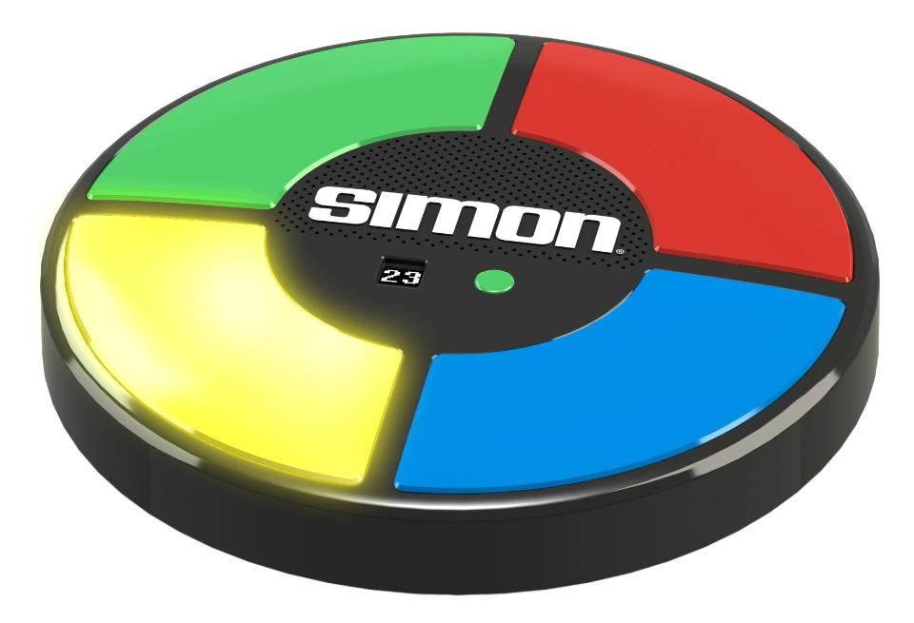
Simon Says
MODULE A

Slide 2
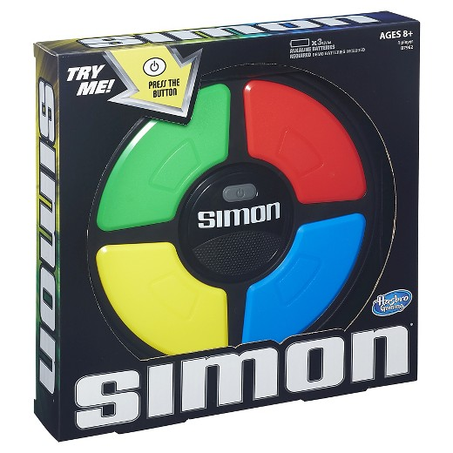
Inventers
Simon is an electronic game of memory skill invented by Ralph H. Baer and Howard J. Morrison, with software programming by Lenny Cope.

Slide 3
History Of The Simon Game
The Inventor of this game is Ralph Baer and he is best known for developing the first video game system. In 1972, Baer started an independent consulting business and began to work in association with Marvin Glass & Associates in Chicago. These individuals are responsible for some of the most successful American toys of the 20th century. Ralph was the creator of the first ever game system called Brown Box, but in 1978, they created their best-known game which was the Simon game.

Slide 4
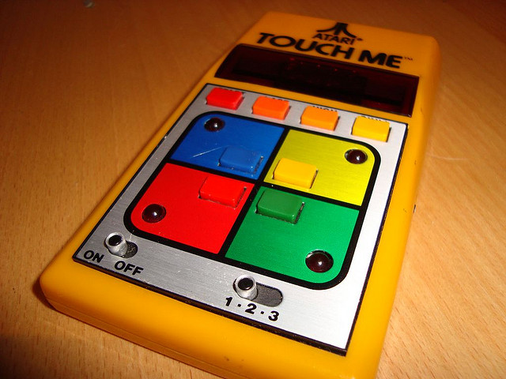
Simon Game
The Simon game was influence by the game called touch me.
Touch Me is an arcade game first released by Atari Inc. in the early1974
The players are allowed to make three mistakes before the game ends and they have to restart

Slide 5
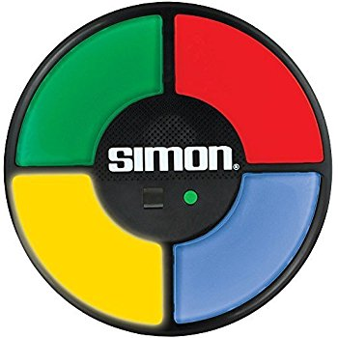
How to play
When you turn the Simon game on, it gives you more than one option. Clicking the green button, it will allow the co-op mode, clicking the red button it allows the single player mode. The Yellow button will show you the highest score. For any colour you select it will start the game and you would have to repeat the colors it displays.

Slide 6
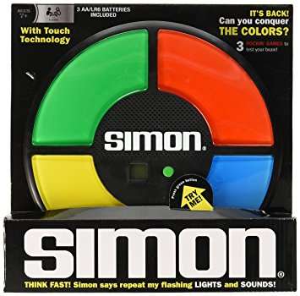
Simon game JavaScript
<div class="row"> <div class="col-md-12"> <div class="gamefield"> <div class="btn-sett" data-toggle="modal" data-target="#myModal"> <h5>Settings</h5> </div> <div class="top-row"> <div id="blue" class="gamebutton" onClick="addToPlayer(this.id)"></div> </div> <div class="middle-row"> <div id="green" class="gamebutton" onClick="addToPlayer(this.id)"></div> <div id="gameNumber"> <h2 id="clickNumber">0</h2></div> <div id="red" class="gamebutton" onClick="addToPlayer(this.id)"></div> </div> <div class="bottom-row"> <div id="dark" class="gamebutton" onClick="addToPlayer(this.id)"></div>

Slide 7
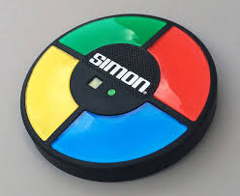
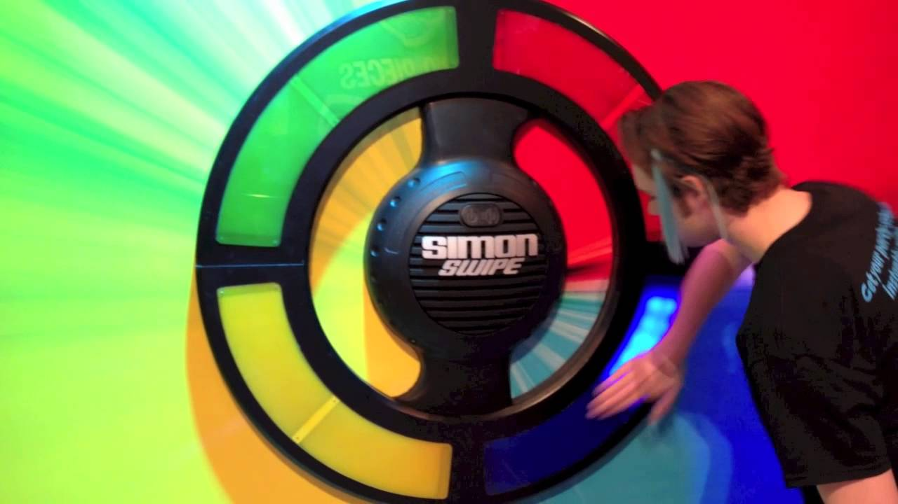
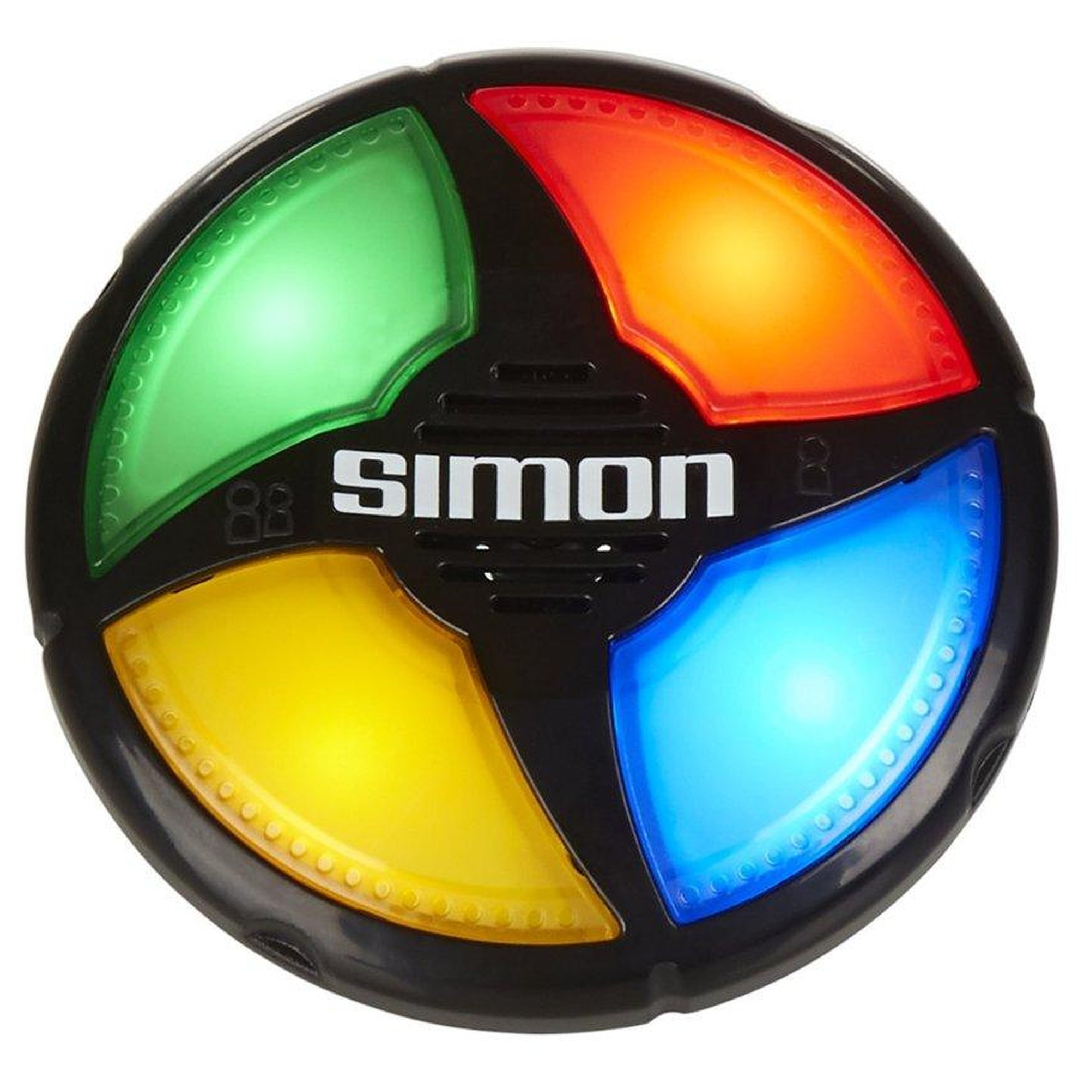
The End

